Slide 1

Application Development with C++ (ELEC362)
Lecture 13: Basics of Qt
mihasan@liverpool.ac.uk

Slide 2
Previous lecture
The basics of software engineering were introduced and discussed.
The waterfall model was discussed with its advantages and disadvantages.
The requirement analysis, software design, validation and verification, and maintenance were discussed.
The incremental model was presented and discussed.

Slide 3
This lecture
What is covered in this lecture?
1. Introduction to Qt library. 2. How to deploy a stand-alone app using Qt.
Why it is covered?
To understand how Qt is structured as a library and how an application can be made independent from Qt.
How are topics covered in this lecture:
Live demonstration

Slide 4
Why Qt??
There are many C++ libraries aimed at GUI application development, including
GTK+, Qt, MFC, and JUCE.
Qt is one of the most widely supported GUI libraries, with a lot of online documentation, examples, tutorials, and supportive community.
It can be integrated very well with other libraries such as OpenGL (graphics library) and Boost (math-based libraries).
Qt is a cross-platform IDE that creates applications working on Windows, Linux, Mac-OS, Android, and many embedded systems.

Slide 5














Why Qt??
Examples of known software built using Qt:
Examples of known companies that use Qt for their software
development:

Slide 6
Qt resources and learning outcomes
Books: Learn Qt 5: N Sherriff (2018).
C++ GUI Programming with Qt, J Blanchette & M Summerfield (2008).
Online documentation: https://doc.qt.io/
https://wiki.qt.io/Main
Online developers community: https://forum.qt.io/
What you will learn is:
1. How to use Qt to develop Graphic User Interface (GUI)-based applications.
2. How to effectively use online documentations and resources for self-learning in programming context.

Slide 7
Qt basics
Qt has been been created in 1991, since then it has been growing.
Qt is a C++ Library used to develop GUI applications for cross-platform applications.
It is available under a commersial license and in a open-source licensces.
It consists of more than 2100 classes!! Each class has more than 7-10 functions!!
Full list of classes can be found here: https://doc.qt.io/qt-6/classes.html
The name of every class in Qt starts with a “Q”.
The class names are carefully chosen to reflect their purpose.

Slide 8
Qt class hierarchy
QObject
QDialog
QTimer
QEvent
QWidget
QFileDialog
QInputEvent
QPaintDevice
QMainWindow
QColorDialog
QKeyEvent
QPixmap
QImage
QMouseEvent
QBitmap
QTouchEvent
QUESTION: Do you notice anything about the names of the classes ??

Slide 9
Qt and C++ relation
Qt was developed using C++.
Qt follows C++ syntax rules.
Many of the widely used classes/containers in C++ were replaced in Qt:
To make the use of Qt more effecint, a new language called “QML“ was developed.
C++ name | Qt equivalent
string | QString
vector | QVector
list | QList

Slide 10
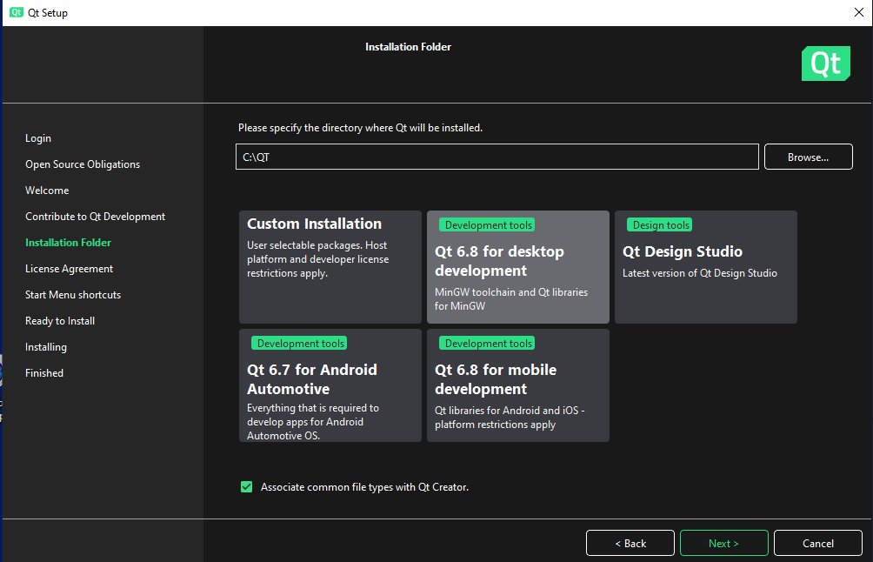
Installation of Qt
In the labs and at the library, Qt is already pre-installed.
For downloading and installing Qt on your computer/laptop, go to:
Make sure that the kit installed is
Qt 6.9.
https://www.qt.io/download-open-source
Choose a package that matches the platform of the application

Slide 11
Qt creator
The name of IDE software for Qt is “Qt creator”.
The name of the GUI editing part of Qt creator is known as “Qt designer”.
A Qt creator walkthrough (demonstration).
Considering that 2100 classes is a large number to handle, classes are categorised into “modules”, each module is particularly suited for the hardware of the platform it is developed for.
A full list of modules is given here: https://doc.qt.io/qt-6/qtmodules.html

Slide 12
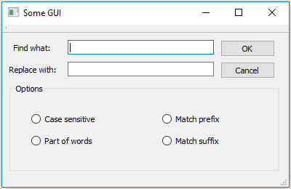



How do GUI applications work?
GUI applications work as follows:
The application
The user
What the application developers do is: 1. Design the GUI using objects from the library.
2. Connect the objects to one another in a functional way.

Slide 13
Deploying an application
Qt creates the application easily within the IDE.
The IDE generates an executable file that has dependencies. To make it a stand-alone application, the dependencies need to be put in the same folder as the exe file. Converting the application into a stand-alone app is known as “deploying”.
For Windows application, one can use “Dependencies Walker” to determine which libraries an executable file need to run (http://www.dependencywalker.com/)
Deploying stand-alone executable from Qt (demonstration).

Slide 14
Deploying an application
The needed libraries can be found in the “bin” folder in the installation folder of the Qt compiler installed for the platform (in our case the MinGW).
The required libraries also depend on the type of build:
Note that the list of libraries may change based on the module used and the platform. Best use Dependency Walker to check.
Libraries needed for windows build (all have .dll extension)
libgcc_s_seh-1, libstdc++-6, libwinpthread-1, Qt6Core, Qt6Gui, Qt6Widgets

Slide 15
Summary
Justification for learning Qt was given.
Basic structure of Qt was explained.
An introduction to Qt Creator was given.
Deploying an application using Qt was explained.

